Slide 1



A Dive into Pokémon's In-game Stats
By Elliot Kerr
Notes:
Good Morning, Afternoon, Evening or Night and welcome to a dive into Pokemon’s in-game stats.
My Name is Elliot Kerr, I’m a Maths Graduate from the university of Bath with a keen interest in both Pokemon and Data Science, which is what this project is about.

Slide 2


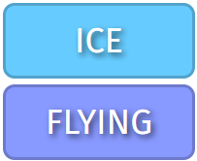




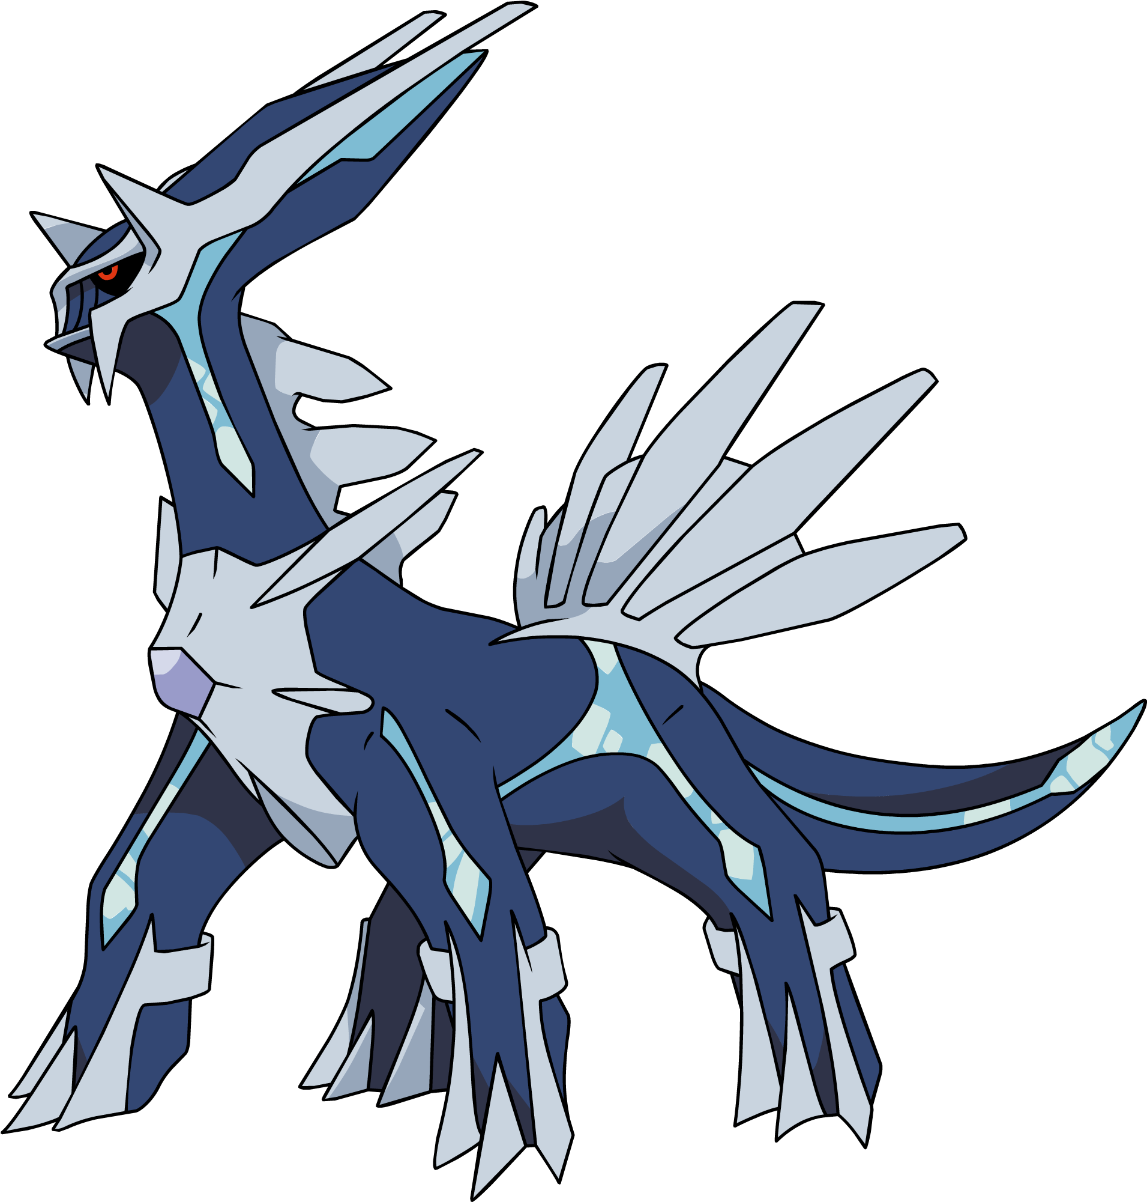




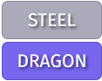

What is Pokemon? And what are Pokemon?
Pokemon is a videogame made by GameFreak, a Japanese based game designer. Pokemon Red and Blue was initially released on the Game Boy in 1996, and after it became a big hit a trading card game and animated series followed.
These games have been a big hit ever since, making The Pokemon Company (TPC) large sums of money.
In the Pokemon games, the main character (you) is challenged to catch, train and battle with the creatures known as Pokemon. With each generation of Pokemon games comes new Pokemon, a new region and a new main character.
Why am I telling you all this backstory? Well, each Pokemon that is designed will be different to others. These differences may be in
the type of a pokemon,
the ability,
hidden ability
or the stats!
The data provided contained the names of the Pokemon, the stats and the types, so we have a few pieces of information to analyse.
Stats:
HP - 100
Atk - 100
Def - 120
SpAtk - 150
SpDef - 120
Spe - 90
Total - 680
Stats:
HP - 100
Atk - 120
Def - 120
SpAtk - 150
SpDef - 100
Spe - 90
Total - 680
Ability:
1. Intimidate
2. Flash Fire
Ability:
1. Steam Engine
2. Flame Body
Ability:
1. Pressure
Hidden Ability:
1. Telepathy
Ability:
1. Pressure
Hidden Ability:
1. Telepathy
Ability:
1. Blaze
Hidden Ability:
1. Speed Boost
Ability:
1. Blaze
Hidden Ability:
1. Iron Fist
Notes:
For those of you that are unaware what Pokemon is…
Pokemon is a video game made by Game Freak. They released Pokemon Red and Blue on the Game Boy in 1996 and it became a massive hit. Since then, they’ve created 9 generations, multiple side games, a trading card game and animated content.
In the Pokemon games, the main character (you) is challenged to catch, train and battle creatures known as Pokemon.
With each generation of Pokemon games comes new Pokemon, a new region, new story and a new main character.
Why am I telling you this? Well, each Pokemon designed will be different to others. The differences may be in the type, ability, hidden ability or even the stats.
The data provided contained the names of the Pokemon, the stats and the types, so we have a few pieces of information to analyse.

Slide 3
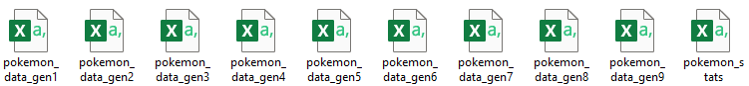
Every piece of data analysis needs a question to answer, so we will be looking into how the in-game stats of Pokemon have changed throughout the makings of new Pokemon games.
To begin with we needed data. So, after a quick search on Kaggle I found a few datasets containing information about Pokemon. The folder contained 10 files, 9 of which were Pokedex’s for all 9 generations and one contained the stats of every pokemon up until the end of generation 9.
We came across a couple of problems though. Firstly, the new pokemon from the generation 9 DLC’s were not included, and the types provided in the Pokedex datasets were incorrect. Some were given incorrect secondary typing's, and some were given secondary typing's even if there were monotype. This was an issue since the data would be inaccurate.
With no other idea of how to fix this, I manually added all missing pokemon and added all typing’s to the Stats dataset. To make things easier in the future, I also added a “species” column since some pokemon have different variants, an “information” column to allow some filters to be created and a colour column to help differentiate between the different “information” entries. These changes were made in excel, where I used filters to speed up the process
Finally, we have a dataset with every pokemon, mega evolution, primal reversion, regional variant and form seen in any pokemon game giving us the best data to begin the analysis!
Notes:
Every piece of data analysis needs a question to answer, so we will be looking into how the in-game stats of Pokemon have changed throughout the makings of new Pokemon games.
To begin with we need data. So, after a quick search I found a few datasets containing information about Pokemon. The folder contained 10 files, 9 of which were Pokedex’s and one contained the stats of every pokemon up until the end of generation 9.
We came across a couple of problems though. Firstly, the new pokemon from the generation 9 DLC’s were not included, and the types provided in the Pokedex datasets were incorrect. Some were given incorrect secondary typing's, and some were given secondary typing's even if there were monotype. This was an issue since the data would be inaccurate.
With no other idea of how to fix this, I manually added all missing pokemon and added all typing’s to the Stats dataset. To make things easier in the future, I also added a “species” column and an “information” column. These changes were made in excel, where I used filters to speed up the process
Finally, we have a dataset with every pokemon, mega evolution, primal reversion, regional variant and form seen in any pokemon game giving us the best data to begin the analysis!

Slide 4
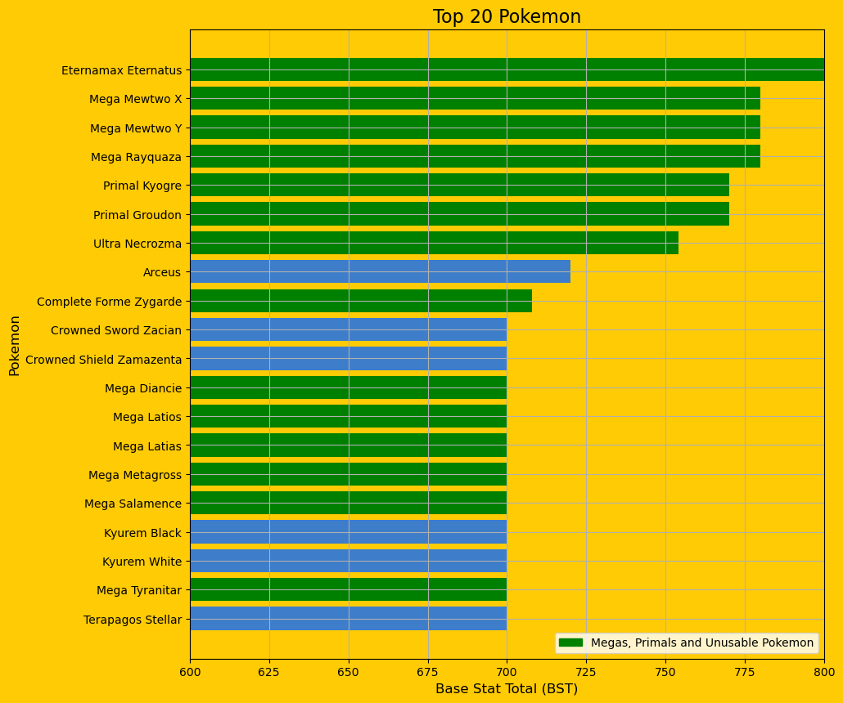
So, this brings us to our initial piece of analysis. We are going to be looking into Pokémon's Base Stat Total (BST). To begin with, it is best to plot our top 20 pokemon to see who they are and what entries are given in the “information” column.
From the legend at the bottom of the plot, we can see any pokemon in green is a Mega Evolution, a Primal Reversion or a pokemon that cannot be used in game for any reason.
Since we only have 6 pokemon in the top 20 that are not in these categories, we will remove all pokemon that would be plotted in green. We will return to Mega Evolutions briefly towards the end.
We can remove these pokemon by creating two Boolean masks, specifying any Pokemon with “Mega/Primal” or “Inaccessible In-game” in the information column.
Notes:
So, this brings us to our initial piece of analysis. We are going to be looking into Pokémon's Base Stat Total (BST). To begin with, it is best to plot our top 20 pokemon to see who they are and what entries are given in the “information” column.
From the legend at the bottom of the plot, we can see any pokemon in green is a Mega Evolution, a Primal Reversion or a pokemon that cannot be used in game for any reason.
Since we only have 6 pokemon in the top 20 that are not in these categories, we will remove all pokemon that would be plotted in green. We will return to Mega Evolutions briefly towards the end.
We can remove these pokemon by creating two Boolean masks, specifying any Pokemon with “Mega/Primal” or “Inaccessible In-game” in the information column.

Slide 5
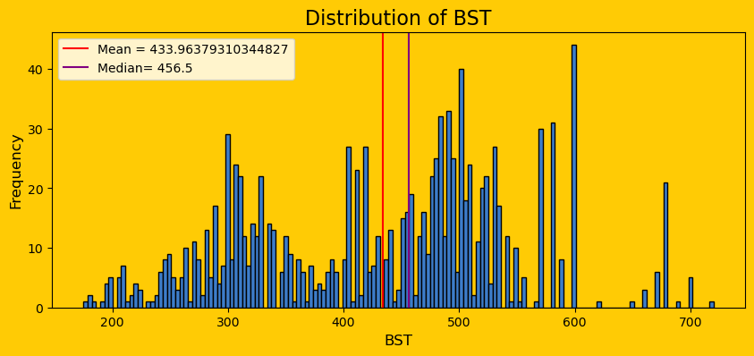
So, after removing the necessary pokemon let’s see how the base stats are distributed over the 1025 pokemon in the pokedex
Large Mode at 600 BST
If we look between 200 and 400, it looks like a small bell curve. A similar thing happens around 500 too. Overall, it is multimodal with the largest being at 600. There are approximately 45 pokemon that share this BST and very few are above this.
There is also a mode at between 400 and 450. This is likely caused by the mid stage evolutions which will have a base stat here to then evolve into a pokemon with at least 500 BST; as seen by the mode around 500.
Since we have the largest mode at 600 BST, it may be best to look view how many pokemon reside around this value. We can do this by generation and using Boolean masks to create new datasets that we can use to count these pokemon.
Notes:
So, after removing the necessary pokemon let’s see how the base stats are distributed over the entire pokedex
If we look between 200 and 400, it looks like a small bell curve. A similar thing happens around 500 too.
Overall, it is multimodal with the largest being at 600. There are approximately 45 pokemon that share this BST and very few are above this.
There is also a mode at between 400 and 450. This is likely caused by the mid stage evolutions which will have a base stat here to then evolve into a pokemon with at least 500 BST; as seen by the mode around 500.
Since we have the largest mode at 600 BST, it may be best to look view how many pokemon reside around this value. We can do this by generation and using Boolean masks to create new datasets that we can use to count these pokemon.

Slide 6
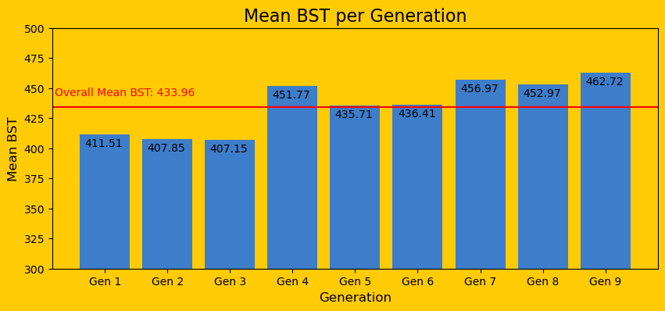
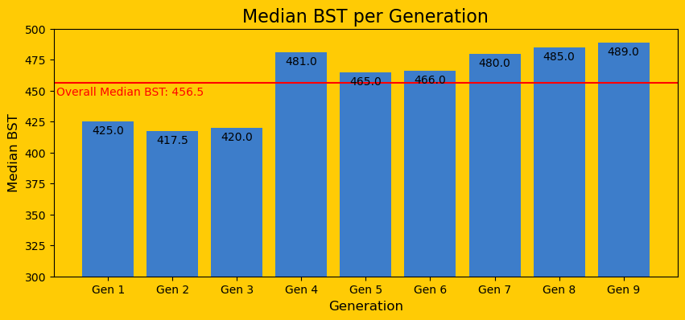
In Python, I created new variables for the mean, median, minimum and maximum BST for each generation, then created new Data Frames that include only pokemon with a BST of at least 600 and one that contains pokemon with a BST over 600 and plotted the pokemon in the second data frame for each generation. This is generalised more in a later slide where we have plots for 3 groupings of generations.
I then took every mean and median and created a list for each which I then plotted.
Mean:
When sorting the mean plot in generation order, we see that older games have a lower mean then any of the newer games. Generation 4 seems to be an outlier here, since it has a similar mean to generation 7 and 8 but when considering the generation 4 pokedex there are 13 legendary and mythical Pokemon which will raise the mean a lot.
Generations 5 and 6 are only a couple of stat points above the mean. This could be an after effect of the generation 4 mean since it is quite a bit higher than the 5 around it.
Median:
Similarly to the mean plot, generations 1, 2 and 3 are below while everything else is above. Generation 4 is still in a similar position to generation 7 while the rest are a bit below the three newest games. Generation 5 is the 4th lowest; however, it is 9 above the mean so it shows how much the first three generations bring the average down.
Notes:
In Python, I created new variables for the mean, median, minimum and maximum BST for each generation, then created new Data Frames that include only pokemon with a BST of at least 600 and one that contains pokemon with a BST over 600 and plotted the pokemon in the second data frame for each generation. This is generalised more in a later slide where we have plots for 3 groupings of generations.
I then took every mean and median and created a list for each which I then plotted.
When sorting the mean plot in generation order, we see that older games have a lower mean then any of the newer games. Generation 4 seems to be an outlier here, since it has a similar mean to generation 7 and 8 but when considering the generation 4 pokedex there are 13 legendary and mythical Pokemon which will raise the mean a lot.
Generations 5 and 6 are only a couple of stat points above the mean. This could be an after effect of the generation 4 mean as it was 40 points higher than generation 3
Similarly to the mean plot, generations 1, 2 and 3 are below while everything else is above. Generation 4 is still in a similar position to generation 7 while the rest are a bit below the three newest games. Generation 5 is the 4th lowest; however, it is 9 above the median so it shows how much the first three generations bring the median down.

Slide 7
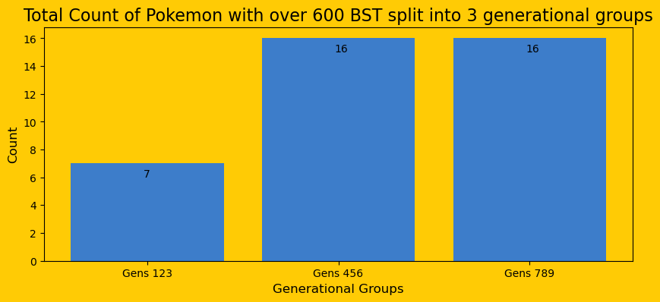
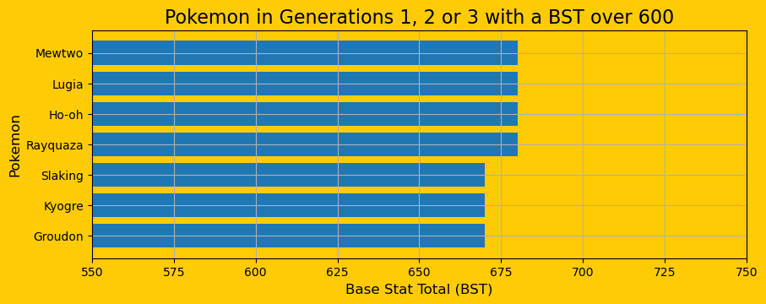
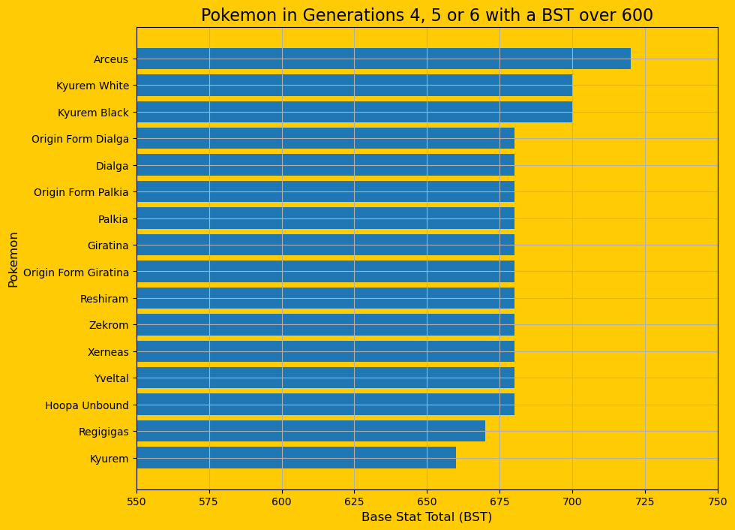
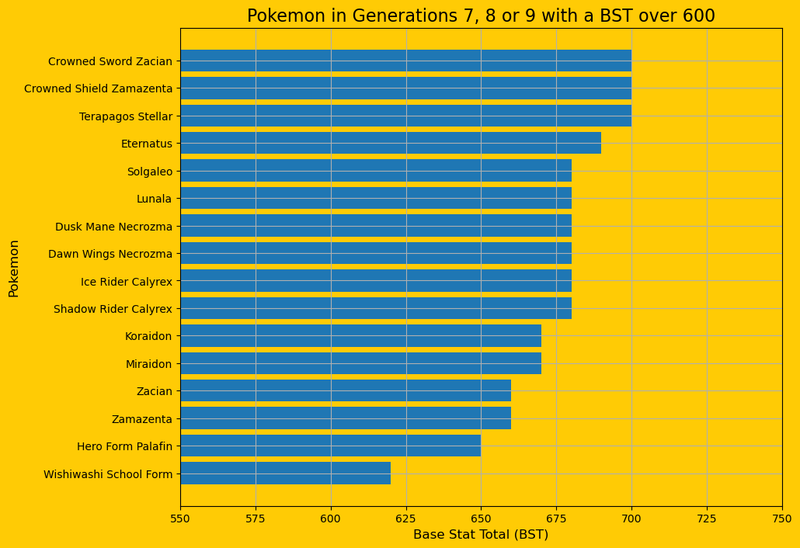
To get a better understanding of the change over time, we can group generations together i.e. Generations 1,2 and 3 can be grouped together as they were all release before the end of 2005. Generations 4,5 and 6 were all released before 2015 and Generations 7,8,9 were all released before 2025. After we have analysed these groups, we can investigate each individually.
We can see a large increase between the first group and the last two. This could be evidence of the evolution of the Pokemon Company's stat design of pokemon throughout the different generations. It may be helpful to see the stats of the pokemon that make up this graph.
It is easier to see the difference when we plot the pokemon individually, since two of the three groups are much longer than the other.
Notes:
To get a better understanding of the change over time, we can group generations together i.e. Generations 1,2 and 3 can be grouped together as they were all release before the end of 2005. Generations 4,5 and 6 were all released before 2015 and Generations 7,8,9 were all released before 2025. After we have analysed these groups, we can investigate each individually.
We can see a large increase between the first group and the last two. This could be evidence of the evolution of the Pokemon Company's stat design of pokemon throughout the different generations. It may be helpful to see the stats of the pokemon that make up this graph.

Slide 8
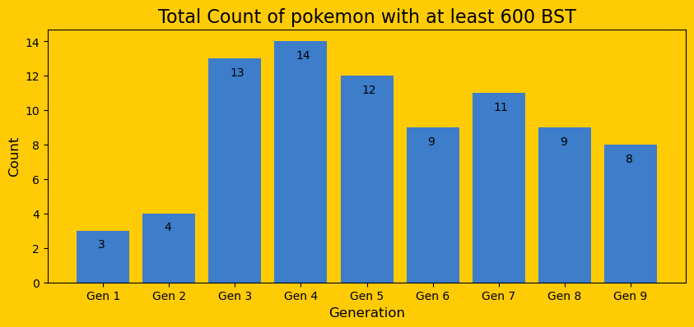
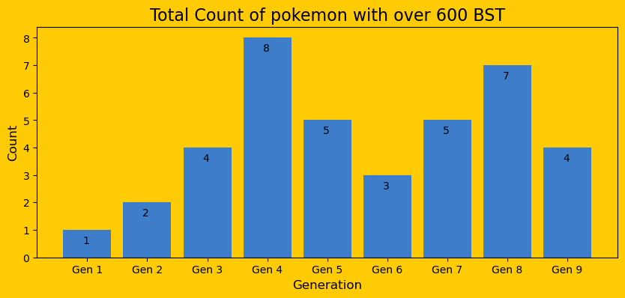
Since we have just looked at the generations grouped together, we should consider the generations separately. By gathering the variables made before, we can plot these very easily.
Since this plot is Pokemon with a BST of at least 600, the counts will be higher for all generations compared to the next graph. We can see a mode at Gen 4 then a slow decrease after. The more important area of the graph is the first two generations which are very low compared to the rest, possibly a result of improvement and evolution of in game stats.
We see another similar situation in the graph for Pokemon with a BST over 600 except this plot is bi-modal with one at gen 4 and one at gen8. Generations 1 and 2 are very low again, then after them we get 2 almost symmetrical bell curves. This may be a pattern for the game designers, although we can only tell after generation 10 has been fully released.
The interesting generation to look at is Generation 3. They have the second highest count of Pokemon >= 600 BST, but the fourth lowest count of Pokemon > 600. This could be because TPC didn’t want too much of a power curve to begin compared to generations 1 and 2.
Notes:
Since we have just looked at the generations grouped together, we should consider the generations separately. By gathering the variables made before, we can plot these very easily.
Since this plot is Pokemon with a BST of at least 600, the counts will be higher for all generations compared to the next graph. We can see a mode at Gen 4 then a slow decrease after. The more important area of the graph is the first two generations which are very low compared to the rest, possibly a result of improvement and evolution of in game stats.
We see another similar situation in the graph for Pokemon with a BST over 600 except this plot is bi-modal with one at gen 4 and one at gen8. Generations 1 and 2 are very low again, then after them we get 2 almost symmetrical bell curves. This may be a pattern for the game designers, although we can only tell after generation 10 has been fully released.
The interesting generation to look at is Generation 3. They have the second highest count of Pokemon with at least 600 BST, but the fourth lowest count of pokemon over 600 BST. This could be because TPC didn’t want too much of a power curve to begin compared to generations 1 and 2.

Slide 9
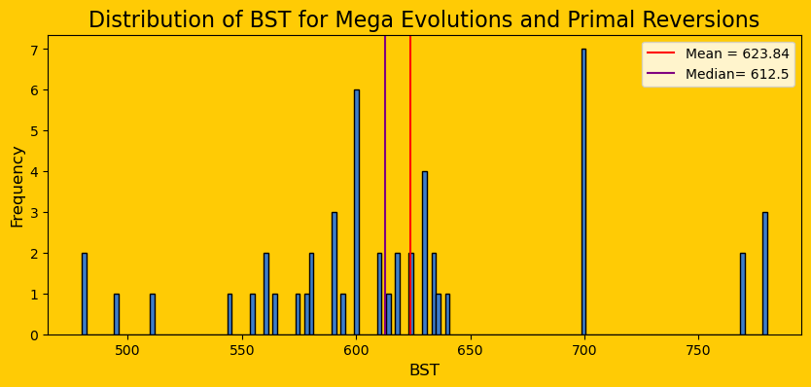
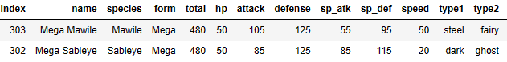
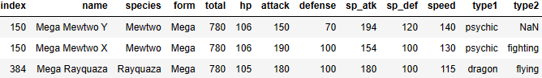
Remember the Mega Evolution and Primal Reversion statements earlier on? No, me neither. Let’s remind ourselves briefly.
I said that the majority of the top 20 were Megas, Primals or Unusable. In fact, 11 of them were Mega Evolutions or Primal Reversions. This is because they have boosted stats over their default counterparts. With 50 Pokemon, it may be best to create a histogram to look at the distribution.
In the histogram, 7 pokemon share the 700 BST, 5 are above 700 and the rest are below. The maximum is at 780 which has 3 pokemon and the minimum is at 480 which has 2 pokemon.
Mawile and Sableye share the weakest mega evolution spot.
And Mewtwo and Rayquaza share the top spot with a BST of 780!
Notes:
Remember the Mega Evolution and Primal Reversion statements earlier on? No, me neither. Let’s remind ourselves briefly.
I said that the majority of the top 20 were Megas, Primals or Unusable. In fact, 11 of them were Mega Evolutions or Primal Reversions. This is because they have boosted stats over their default counterparts. With 50 Pokemon, it may be best to create a histogram to look at the distribution.
In the histogram, 7 pokemon share the 700 BST, 5 are above 700 and the rest are below. The maximum is at 780 which has 3 pokemon and the minimum is at 480 which has 2 pokemon.
Mega Mawile is an interesting Pokemon. It has the joint lowest stats of a Mega Evolution, however sporting the dual type of Fairy and Steel and the ability Huge Power it is no surprise that it got use in competitive battles. Huge Power doubles the attack of a pokemon meaning with any investment Mawile can have an attack stat over 200!

Slide 10
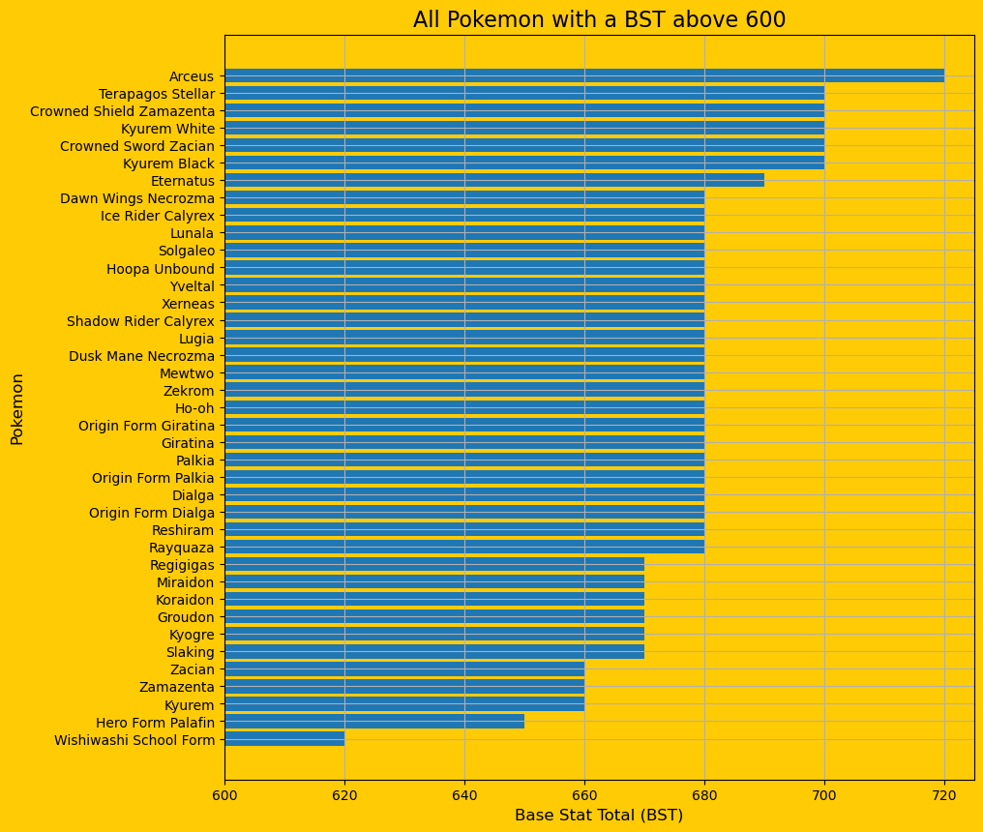
The last thing to look at is how each pokemon stacks up against others. We will do this by plotting all non-mega, non-primal pokemon with a BST over 600. We have 39 pokemon out of 1025 that have a Base Stat Total over 600, so we can just plot them all
We see that the “God Pokemon” Arceus is number 1 followed closely by Terapagos Stellar from Generation 9, Crowned Sword Zacian and Shield Zamazenta from Generation 8 and both Kyurem Black and White from Generation 5.
The majority of the pokemon in this list are legendaries or mythicals, but we have 3 that aren’t. These three pokemon are Slaking, Hero Form Palafin and Wishiwashi School Form.
Notes:
The last thing to look at is how each pokemon stacks up against others. We will do this by plotting all non-mega, non-primal pokemon with a BST over 600. We have 39 pokemon out of 1025 that have a Base Stat Total over 600, so we can just plot them all
We see that the “God Pokemon” Arceus is number 1 followed closely by Terapagos Stellar from Generation 9, Crowned Sword Zacian and Shield Zamazenta from Generation 8 and both Kyurem Black and White from Generation 5.
The majority of the pokemon in this list are legendaries or mythicals, but we have 3 that aren’t. These three pokemon are Slaking, Hero Form Palafin and Wishiwashi School Form.

Slide 11




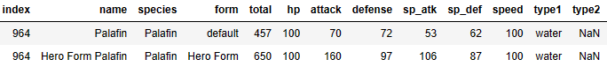

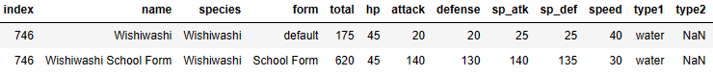
1. Slaking - Slaking is a generation 3 pokemon with ridiculous stats, rivalling those of the box art legendaries from Hoenn. With a 160 base attack stat, it will run through any team. However, these stats come at a cost. Since Slaking isn't a legendary pokemon, they gave it the ability "Truant". This makes it so Slaking can't attack every other turn, making it so the opposition has a turn to do something without massive damage coming from Slaking
2. Hero Form Palafin - New to Generation 9, Palafin is a small dolphin pokemon with mediocre base stats of 457. However, what makes this pokemon so strong is the ability. If Palafin switches out, it will active the ability "Zero to Hero", where Palafin will return to the battle in Hero Form. With the same attack stat as Slaking it packs a punch(no pun intended) using its signature priority water move, "Jet Punch". The obvious draw back for such a strong pokemon is having to switch it out to transform, but you can find work arounds to it
3. Wishiwashi School Form - Native to Alola, Wishiwashi is a generation 7 pokemon with terrible stats. It has 175 total, the least out of all generation 7 pokemon. However, Wishiwashi has an ability "Schooling" where, when above 25% HP, Wishiwashi transforms to it's school form. As seen below, the change is immense. Boasting a 140 base attack and special attack stat, Wishiwashi becomes a menace. Anyone that has played through Sun and Moon will know this from the Trial at Brooklet Hill
Notes:
1. Slaking - Slaking is a generation 3 pokemon with ridiculous stats, rivalling those of the box art legendaries from Hoenn. With a 160 base attack stat, it will run through any team. However, these stats come at a cost. Since Slaking isn't a legendary pokemon, they gave it the ability "Truant". This makes it so Slaking can't attack every other turn, making it so the opposition has a turn to do something without massive damage coming from Slaking
2. Hero Form Palafin - New to Generation 9, Palafin is a small dolphin pokemon with mediocre base stats of 457. However, what makes this pokemon so strong is the ability. If Palafin switches out, it will active the ability "Zero to Hero", where Palafin will return to the battle in Hero Form. With the same attack stat as Slaking it packs a punch(no pun intended) using its signature priority water move, "Jet Punch". The obvious draw back for such a strong pokemon is having to switch it out to transform, but you can find work arounds to it
3. Wishiwashi School Form - Native to Alola, Wishiwashi is a generation 7 pokemon with terrible stats. It has 175 total, the least out of all generation 7 pokemon. However, Wishiwashi has an ability "Schooling" where, when above 25% HP, Wishiwashi transforms to it's school form. As seen below, the change is immense. Boasting a 140 base attack and special attack stat, Wishiwashi becomes a menace. Anyone that has played through Sun and Moon will know this from the Trial at Brooklet Hill

Slide 12
Conclusion
Pokemon have developed a lot over the years. We found that the mean and median BSTs have increased over the years, although some decreased a little compared to previous years.
Grouped together, generations 1,2 and 3 had the lowest mean, median and total count of all pokemon with a BST of at least 600 and over 600. This shows the game designers have created a larger quantity of stronger pokemon compared to the first three generations, most likely due to the adapting to the overall game design each generation. This creates a small power curve, so the next generation will need at least a few pokemon strong enough to "hang" with the others at that level
We have seen some trends and patterns in our graphs that point towards development, although perhaps a peak too soon. Generation 4 was consistently close to the top when it came to means, medians, and counts while the generations after seemed to be lower. Was this a premature spike from TPC? Definitely not, especially after the large count of pokemon with a BST of at least 600 in generation 3. We haven’t returned to this level yet, although generations 8 and 9 got close.
Mega Evolutions and Primal Reversions are very strong. With the minimum BST being larger than the mean for the entire dataset, they are stronger than half the Pokemon. They also contain the 3 strongest usable pokemon in the game's history. The mean is also above 600 which makes sense since 27 of the 50 Megas and Primals have a BST over 600.
Overall, I believe TPC has done a great job of keeping the designs interesting and competitive while also not too overpowering. Even though the first few generations have less strong pokemon than the rest, they began a franchise that entertains millions, and that can’t be overlooked.
If I were to complete this again, I may consider analysing pokemon types or other stats, however this would take a long time to finalise.
Notes:
Pokemon have developed a lot over the years. We found that the mean and median BSTs have increased over the years, although some decreased a little compared to previous years.
Grouped together, generations 1,2 and 3 had the lowest mean, median and total count of all pokemon with a BST of at least 600 and over 600. This shows the game designers have created a larger quantity of stronger pokemon compared to the first three generations, most likely due to the adapting to the overall game design each generation. This creates a small power curve, so the next generation will need at least a few pokemon strong enough to "hang" with the others at that level
We have seen some trends and patterns in our graphs that point towards development, although perhaps a peak too soon. Generation 4 was consistently close to the top when it came to means, medians, and counts while the generations after seemed to be lower. Was this a premature spike from TPC? Definitely not, especially after the large count of pokemon with a BST of at least 600 in generation 3. We haven’t returned to this level yet, although generations 8 and 9 got close.
Mega Evolutions and Primal Reversions are very strong. With the minimum BST being larger than the mean for the entire dataset, they are stronger than half the Pokemon. They also contain the 3 strongest usable pokemon in the game's history. The mean is also above 600 which makes sense since 27 of the 50 Megas and Primals have a BST over 600.
Overall, I believe TPC has done a great job of keeping the designs interesting and competitive while also not too overpowering. Even though the first few generations have less strong pokemon than the rest, they began a franchise that entertains millions, and that can’t be overlooked.
If I were to complete this again, I may consider analysing pokemon types or other stats, however this would take a long time to finalise.

